Slide 1
2.72 Term Project Presentation
Emily Kamienski
May 17, 2021
Project Team Members: Tom Dillon, Sam Gollob, Eric Jorgensen & Cormac O’Neill

Slide 2
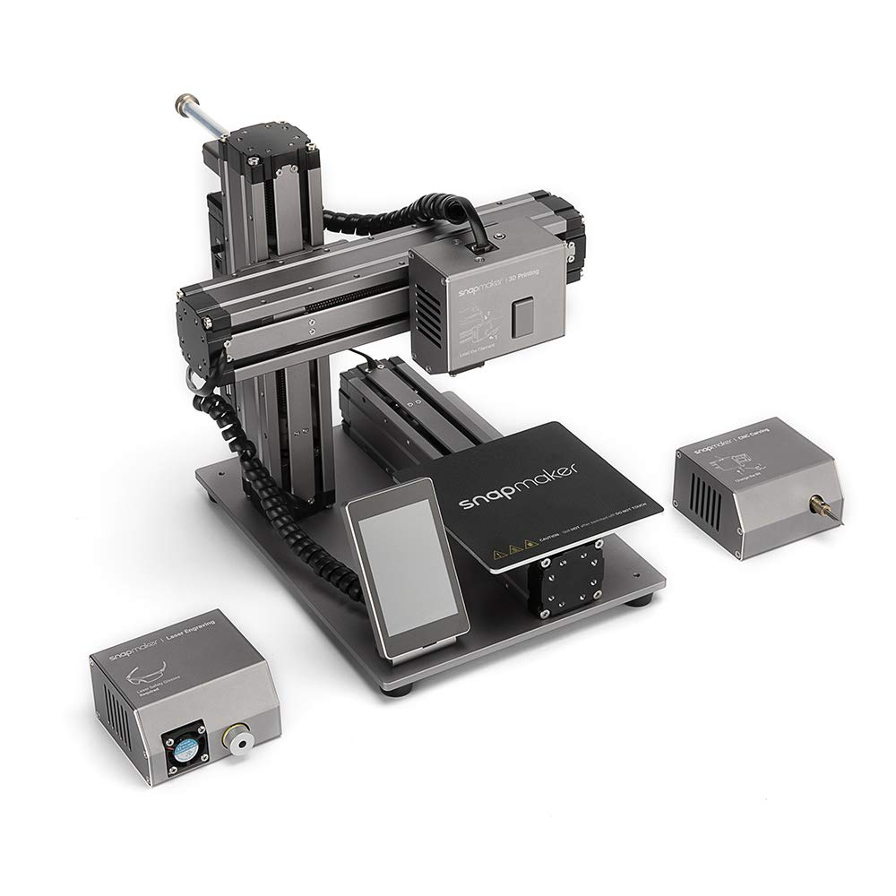
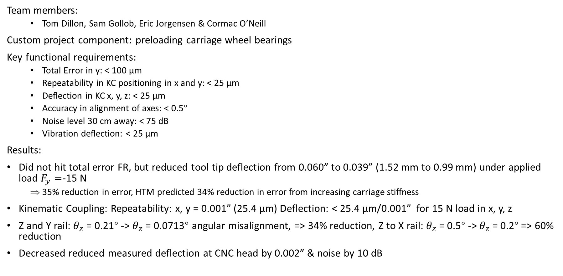
Project Overview
z
y
x
Team members:
Tom Dillon, Sam Gollob, Eric Jorgensen & Cormac O’Neill
Custom project component: preloading carriage wheel bearings
Key functional requirements:
Total Error in y: < 100 μm
Repeatability in KC positioning in x and y: < 25 μm
Deflection in KC x, y, z: < 25 μm
Accuracy in alignment of axes: < 0.5°
Noise level 30 cm away: < 75 dB
Vibration deflection: < 25 μm
Results:
Did not hit total error FR, but reduced tool tip deflection from 0.060” to 0.039” (1.52 mm to 0.99 mm) under applied load $F_{y}=$-15 N
35% reduction in error, HTM predicted 34% reduction in error from increasing carriage stiffness
Kinematic Coupling: Repeatability: x, y = 0.001” (25.4 μm) Deflection: < 25.4 μm/0.001” for 15 N load in x, y, z
Z and Y rail: $θ_{z}$ = 0.21° -> $θ_{z}$ = 0.0713° angular misalignment, => 34% reduction, Z to X rail: $θ_{z}$ = 0.5° ${\text{−>}}_{ }θ_{z}\text{ = 0.}\text{2}$° => 60% reduction
Decreased reduced measured deflection at CNC head by 0.002” & noise by 10 dB
Image credit: Cytron Marketplace
Notes:
Above 80 dB causes hearing damage after 2 hours of exposure - CDC
34% reduction in error from increasing carriage sitffness (assume zero assembly error etc)
, Stiffness of fixture req: 2 N/μm

Slide 3
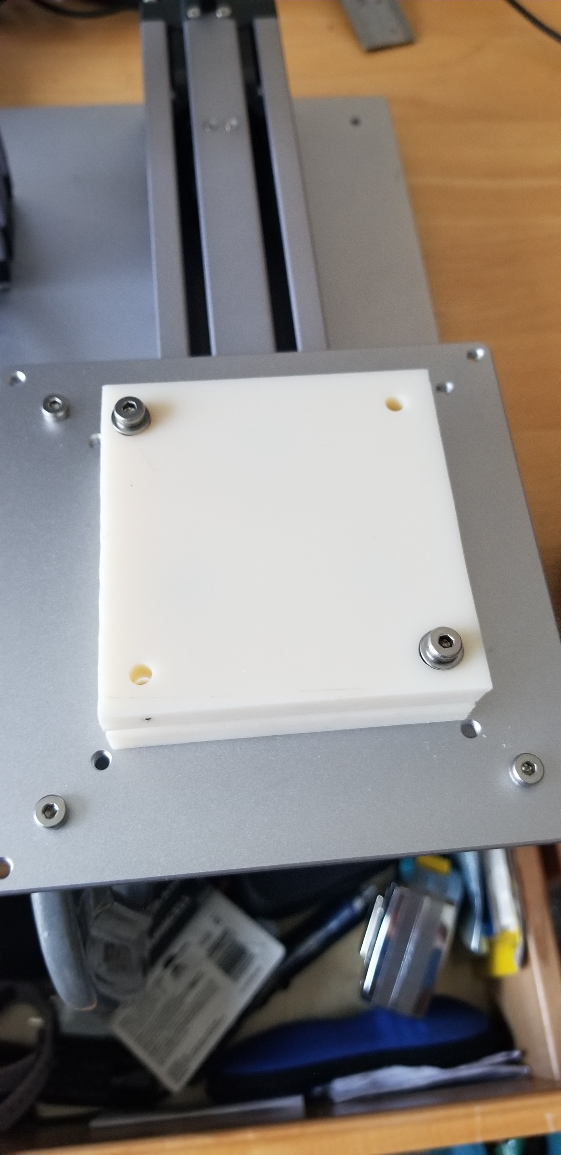
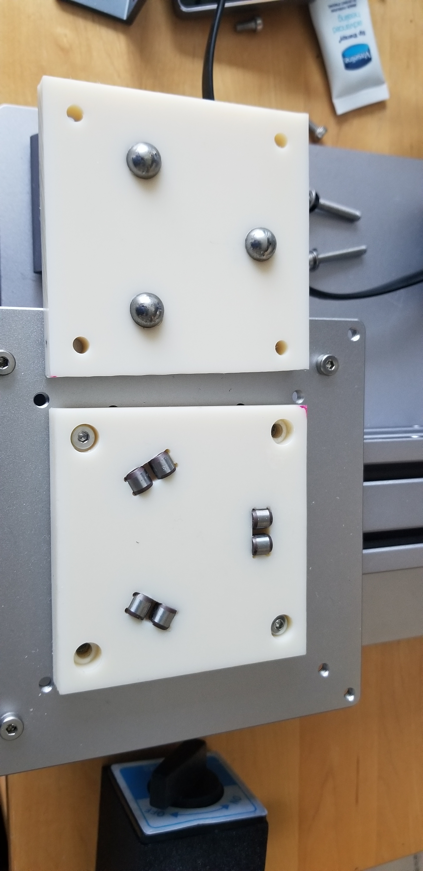
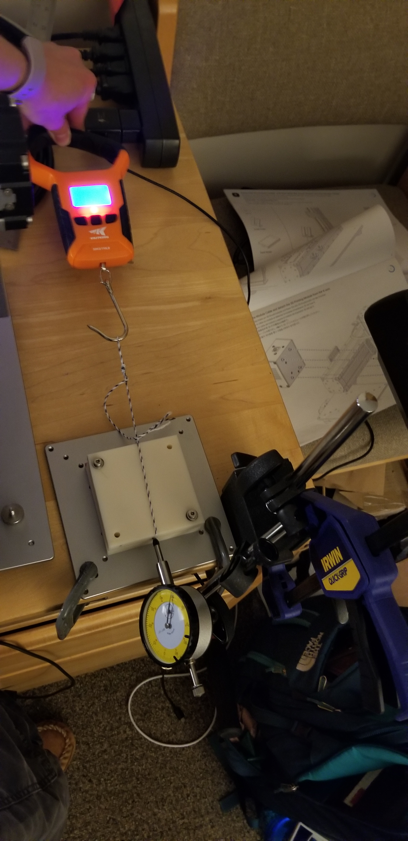
Kinematic coupling
Used spread sheet to inform design
Ordered new dowel pins to get higher Young’s modulus Ultimate Tensile strength(contact stresses too high with provided pins)
Preload required: 26 lbf/115 N
Used wave washers with this working load
Repeatability
Measured: 0.001”/25.4 μm repeatability in x and y
Almost meets FR of 25 μm
Most likely due to assembly error bolt tightening
Displacement under load
Calculated displacement in x, y =4 μm, stiffness = 3.75 N/μm (using spread sheet)
Measured displacement
< 25.4 μm/0.001” for 15 N load in x and y
25.4 μm/0.001” for 44.5 N load in z (calculated -4.7 μm in z)
=> Meets FR of 25 μm
Discrepancy
The measured displacement values were over the calculated values
Spread sheet doesn’t account for pallet stiffness
Notes:
Balance between clamping forces (guards against separation) and stresses on spheres
25.4 μm/0.001” in x and y under 20 N load => stiffness = 0.77 N/μm
stiffness = 0.12 N/μm under 44.5 N load => stiffness = 1.76 N/μm
The measured stiffness values were a little under the calculated values
Required stiffness = 0.6 N/μm (25 μm deflection under 15 N load)

Slide 4
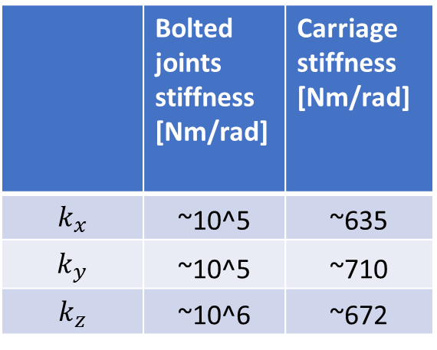
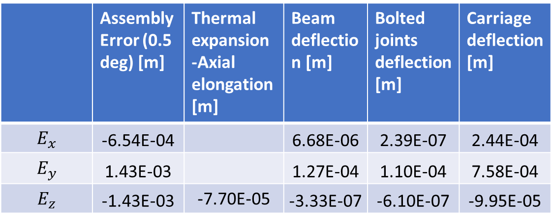
HTM
HTM Model contains: assembly misalignment, Beam deflection, Bolted joint deflection, Carriage deflection, Axial thermal expansion
Estimated cutting forces of 15 N
Focused on deflections in y, worst case scenario (tool at end of x-axis)
 | Assembly Error (0.5 deg) [m] | Thermal expansion -Axial elongation [m] | Beam deflection [m] | Bolted joints deflection [m] | Carriage deflection [m]
$$E_{x}$$ | -6.54E-04 |  | 6.68E-06 | 2.39E-07 | 2.44E-04
$$E_{y}$$ | 1.43E-03 |  | 1.27E-04 | 1.10E-04 | 7.58E-04
$$E_{z}$$ | -1.43E-03 | -7.70E-05 | -3.33E-07 | -6.10E-07 | -9.95E-05
 | Bolted joints stiffness [Nm/rad] | Carriage stiffness [Nm/rad]
$$k_{x}$$ | ~10^5 | ~635
$$k_{y}$$ | ~10^5 | ~710
$$k_{z}$$ | ~10^6 | ~672

Slide 5
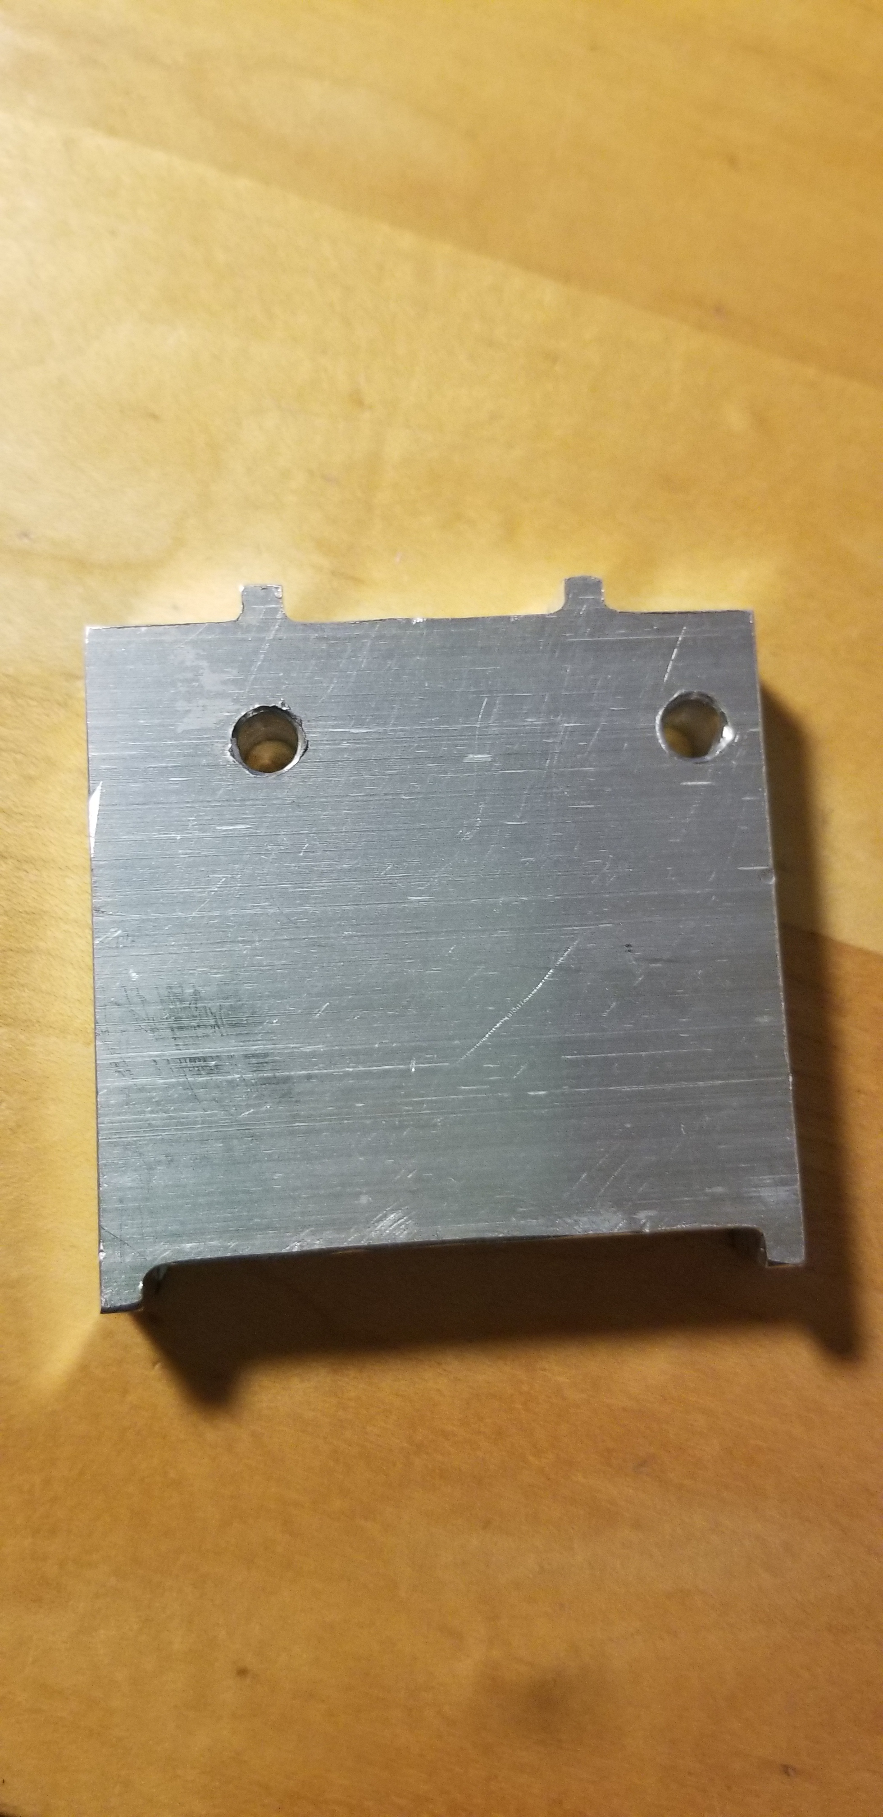
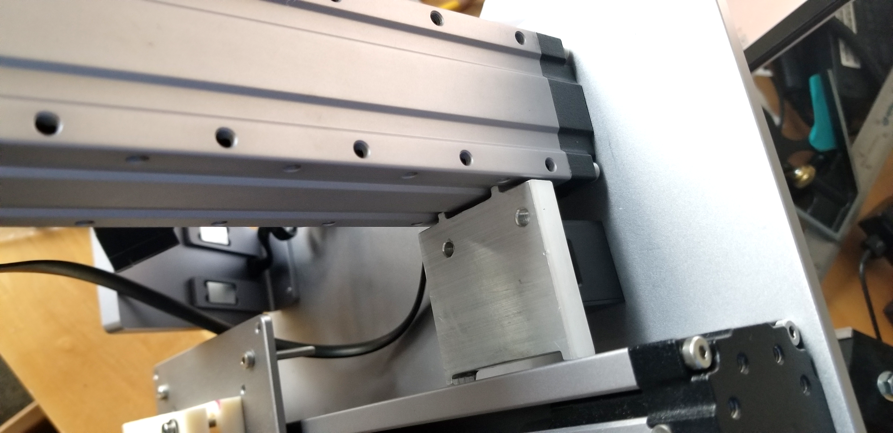
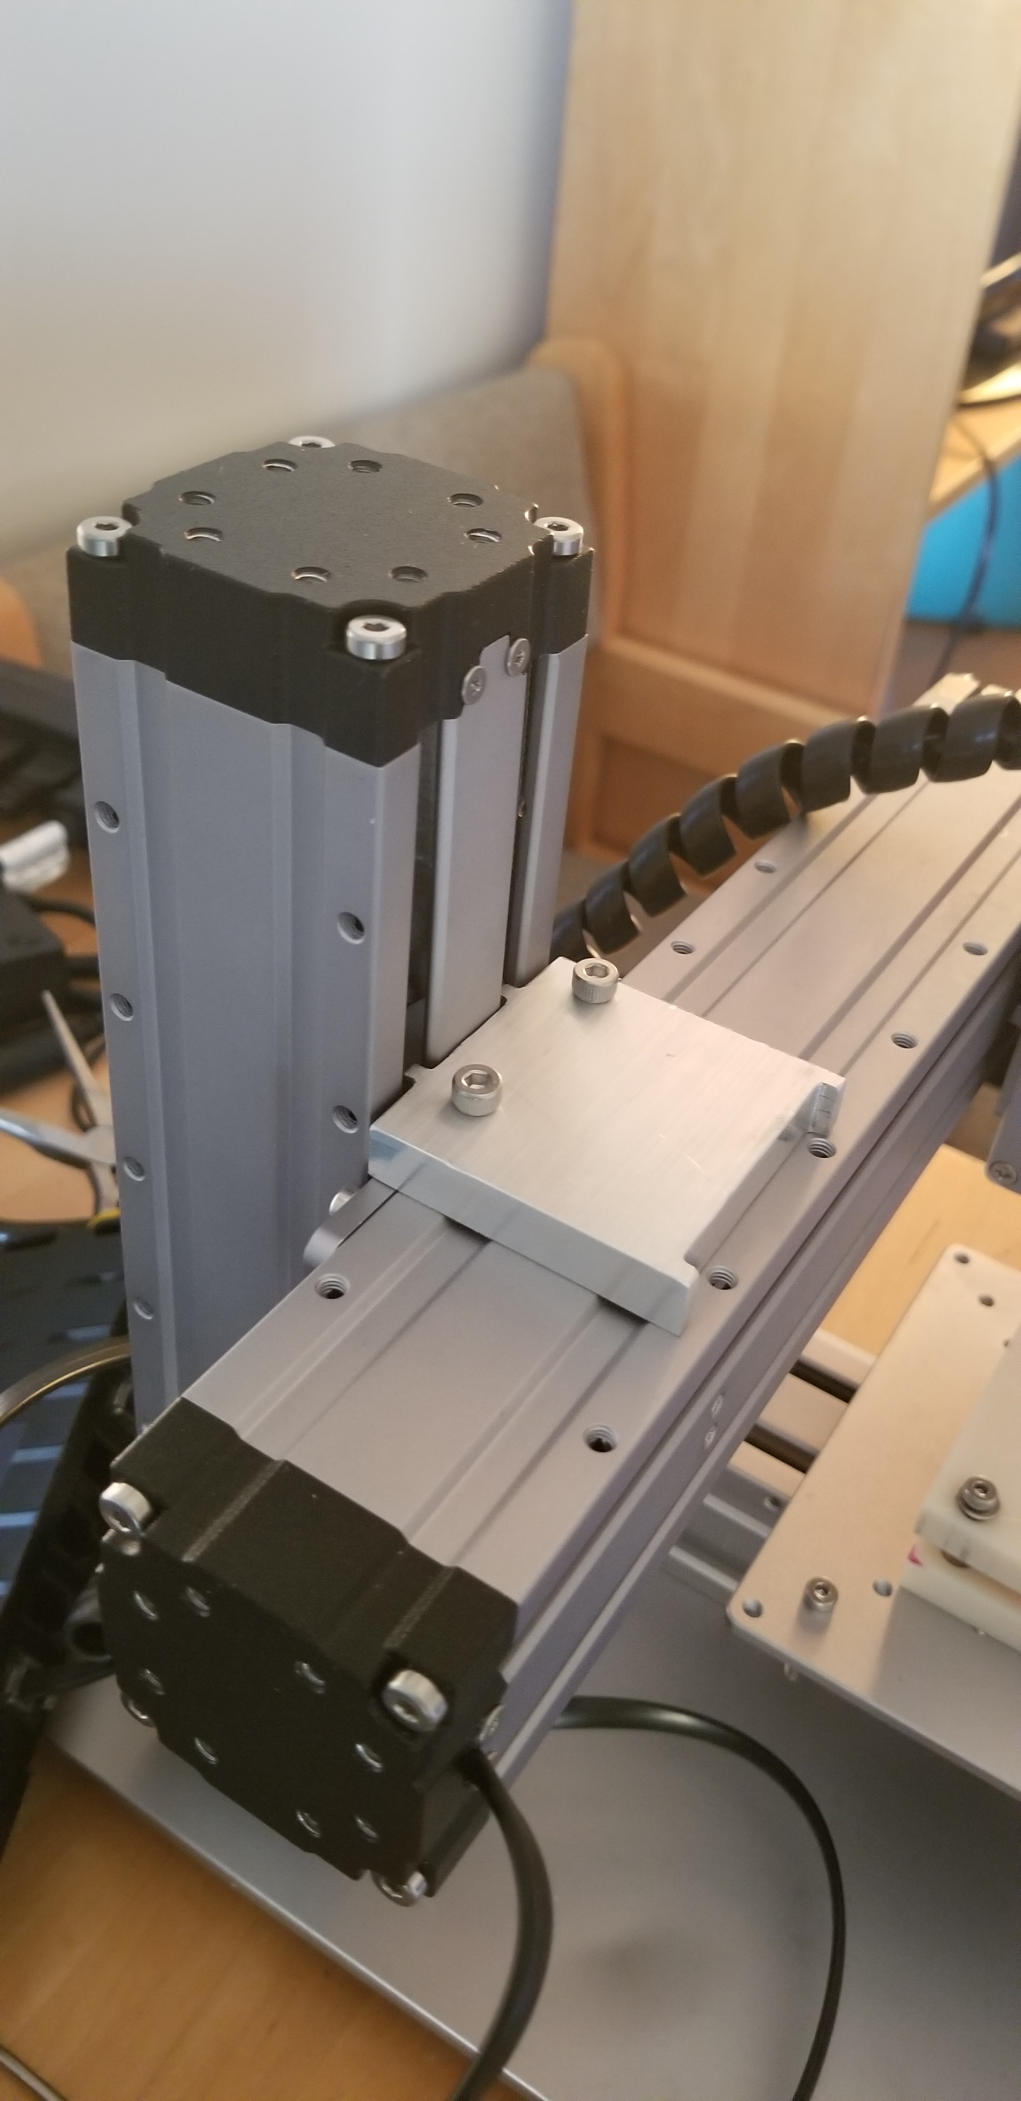
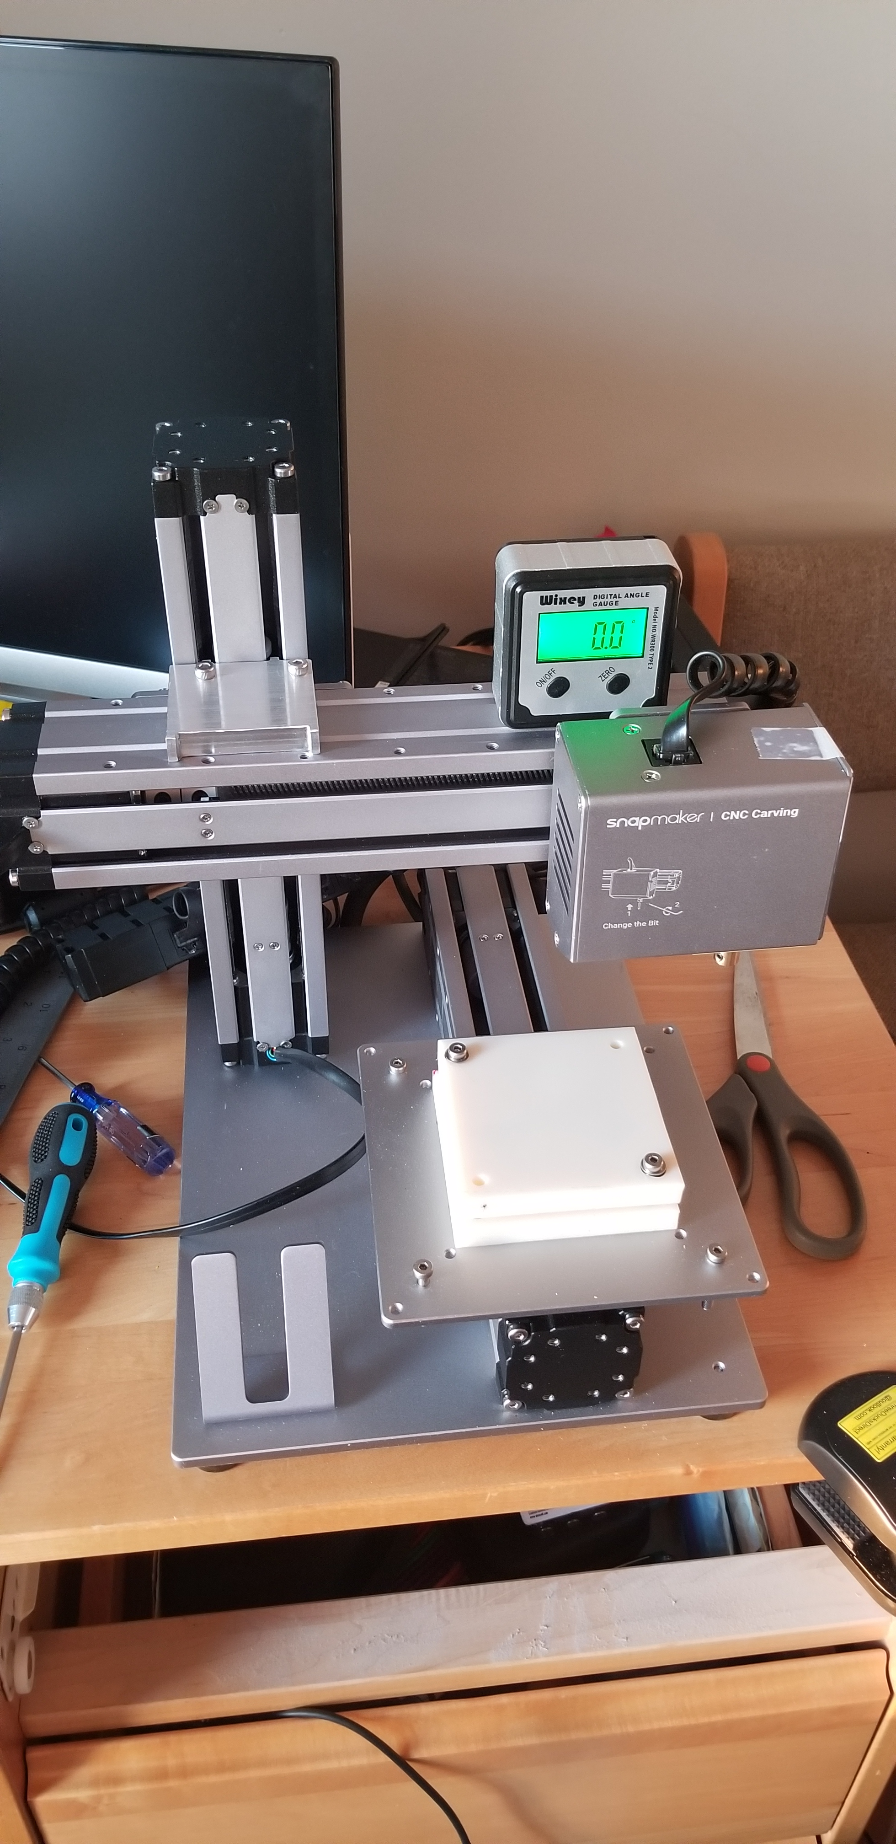
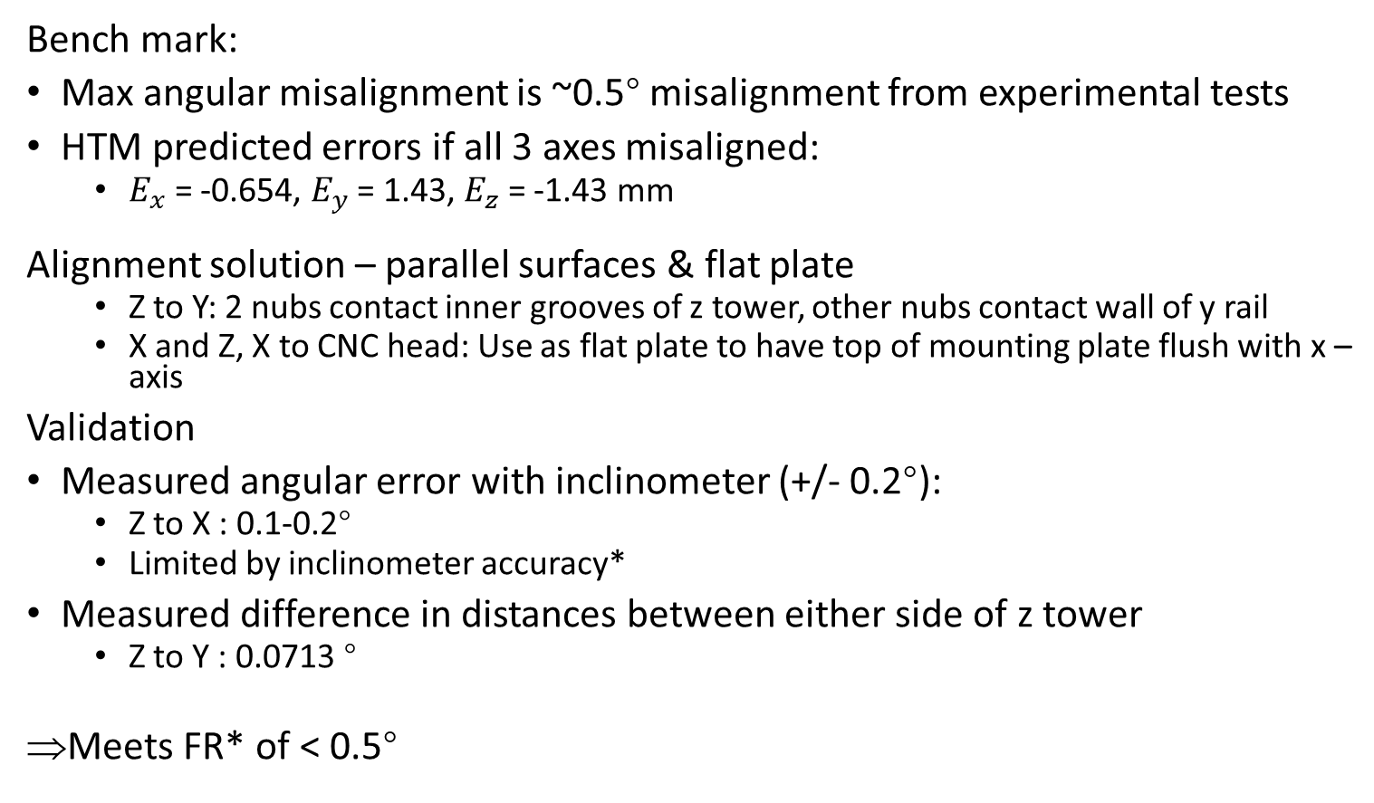


Alignment Device
Alignment device
$$d_{1}$$
Bench mark:
Max angular misalignment is ~0.5° misalignment from experimental tests
HTM predicted errors if all 3 axes misaligned:
$E_{x}$ = -0.654, $E_{y}$ = 1.43, $E_{z}$ = -1.43 mm
-6.54E-04
Alignment solution – parallel surfaces & flat plate
Z to Y: 2 nubs contact inner grooves of z tower, other nubs contact wall of y rail
X and Z, X to CNC head: Use as flat plate to have top of mounting plate flush with x –axis
Validation
Measured angular error with inclinometer (+/- 0.2°):
Z to X : 0.1-0.2°
Limited by inclinometer accuracy*
Measured difference in distances between either side of z tower
Z to Y : 0.0713 °
Meets FR* of < 0.5°
Z to Y
$$d_{2}$$
z
x
Z to Y
y
Z to X
Notes:
3.125 mm endmill

Slide 6
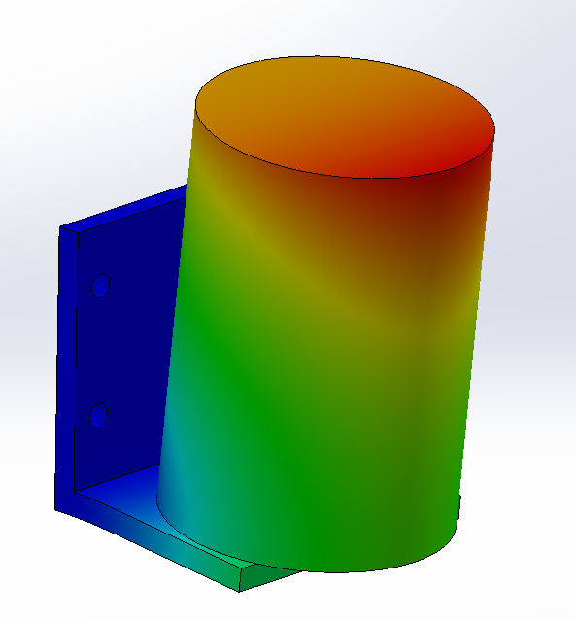
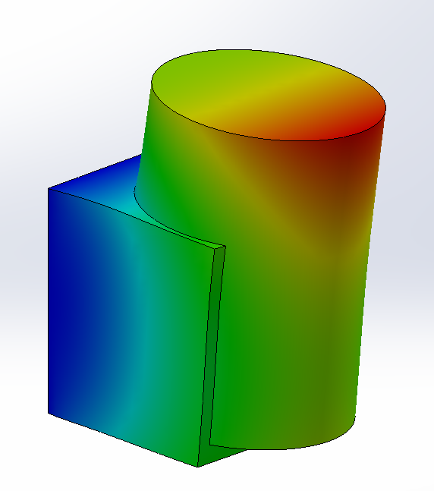
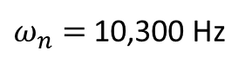
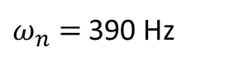
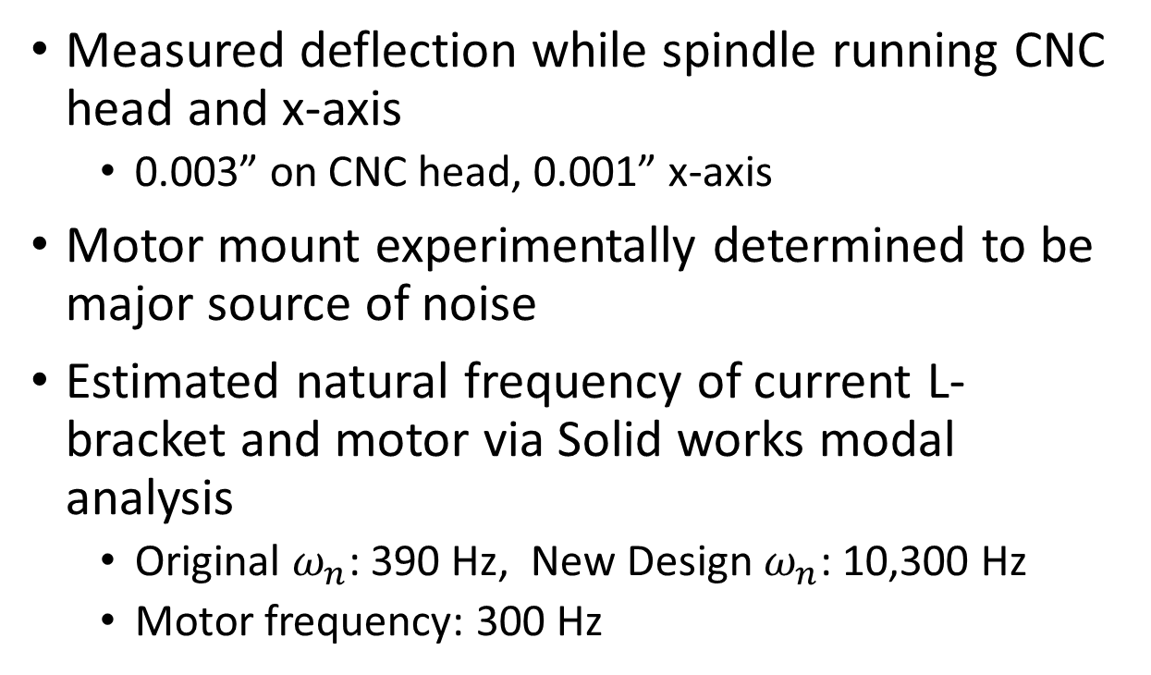
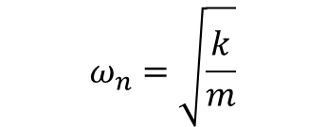
Dynamics – Assessment & Design Change
z
y
x
Measured deflection while spindle running CNC head and x-axis
0.003” on CNC head, 0.001” x-axis
Motor mount experimentally determined to be major source of noise
Estimated natural frequency of current L-bracket and motor via Solid works modal analysis
Original $ω_{n}$: 390 Hz, New Design $ω_{n}$: 10,300 Hz
Motor frequency: 300 Hz
$ω_{n}=$390 Hz
$ω_{n}=$10,300 Hz
Motor not actually fixed to bracket in reality like shown here
$$ω_{n}=\sqrt{\frac{k}{m}}$$
Notes:
Assumed everything aluminum
Measured with accelerometer and integrated to get deflection – matched measured

Slide 7
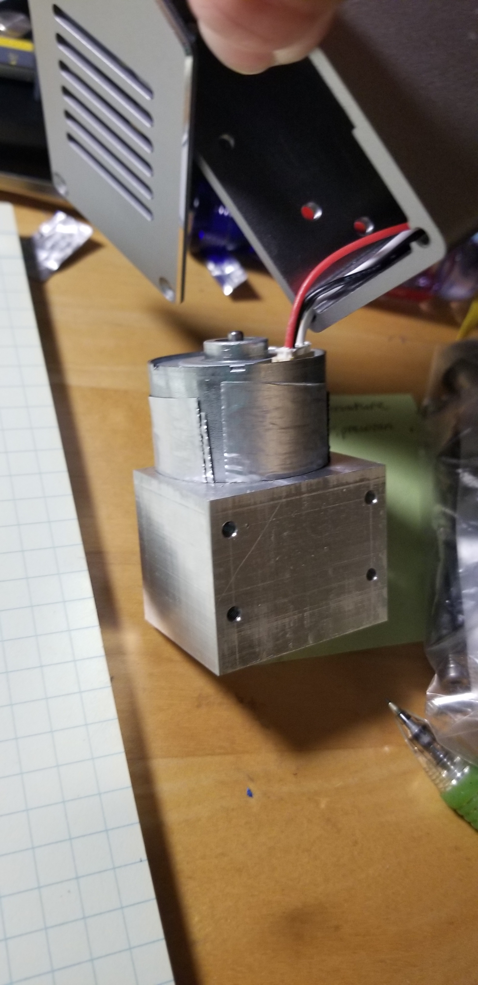
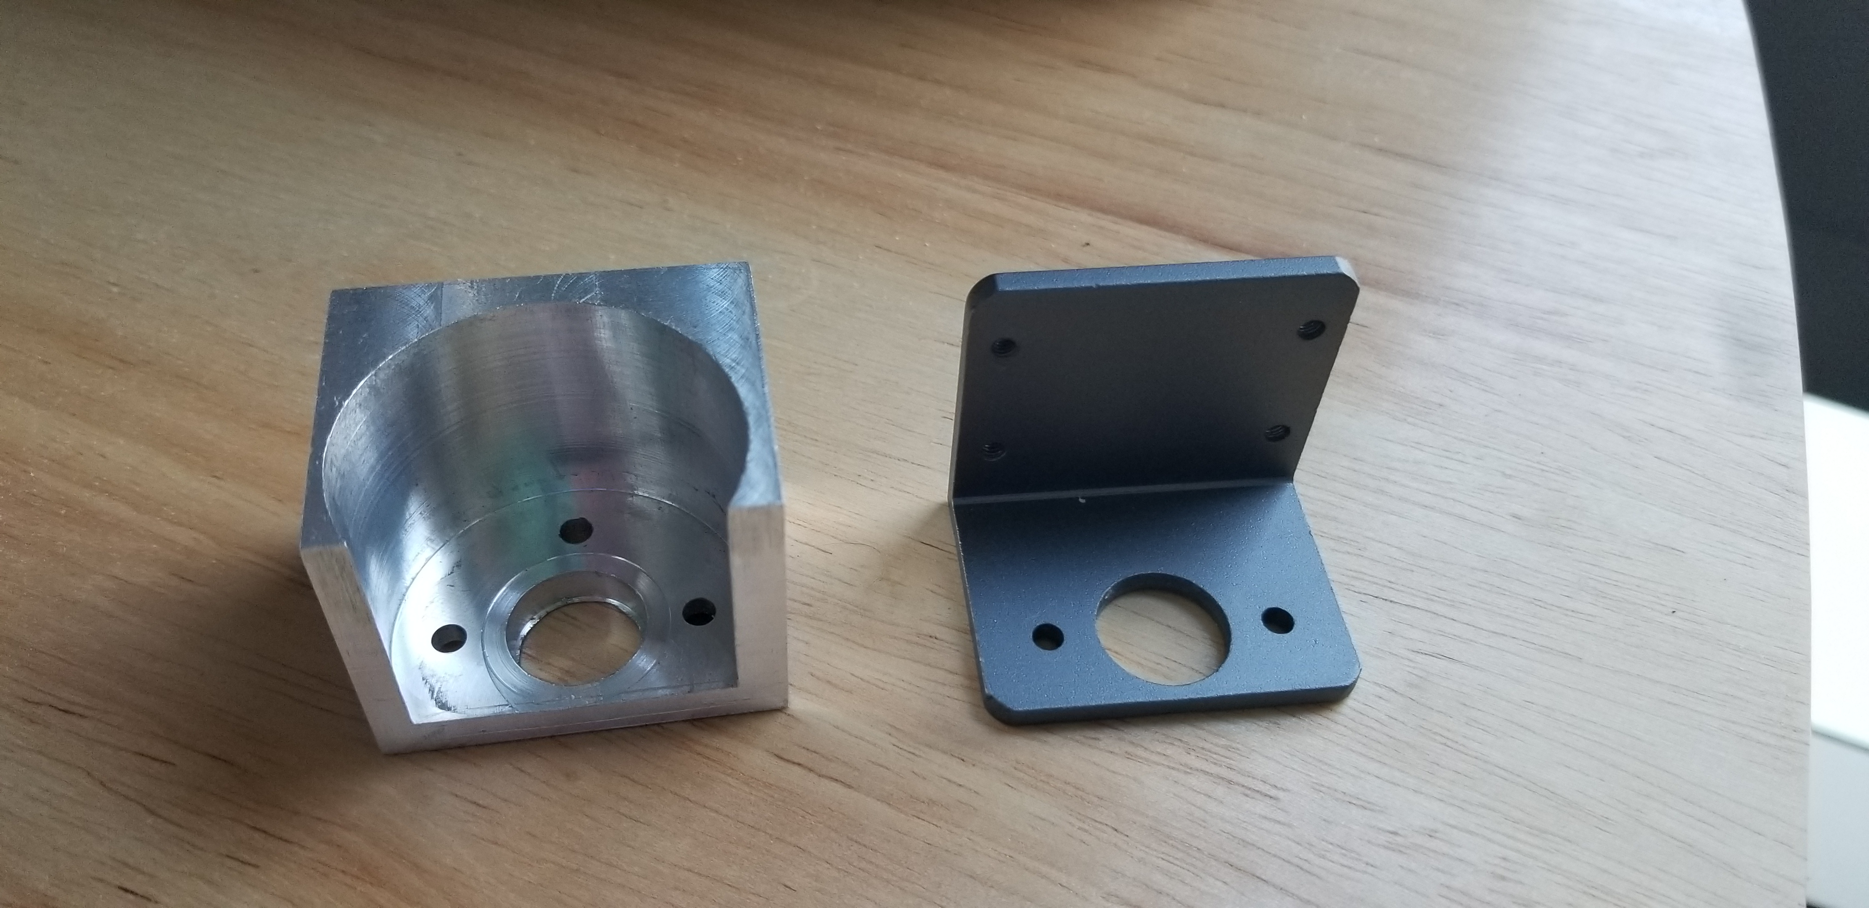
Dynamics – Implementation & Results
Replace L-bracket with new motor bracket to reduce structural loop and increase stiffness
Decreased CNC head deflection from 0.003” to 0.001”
Decreased sound level by from 77 dB to 67 dB with spindle running at 19,000 RPM
=> Meets FR of < 75 dB

Slide 8
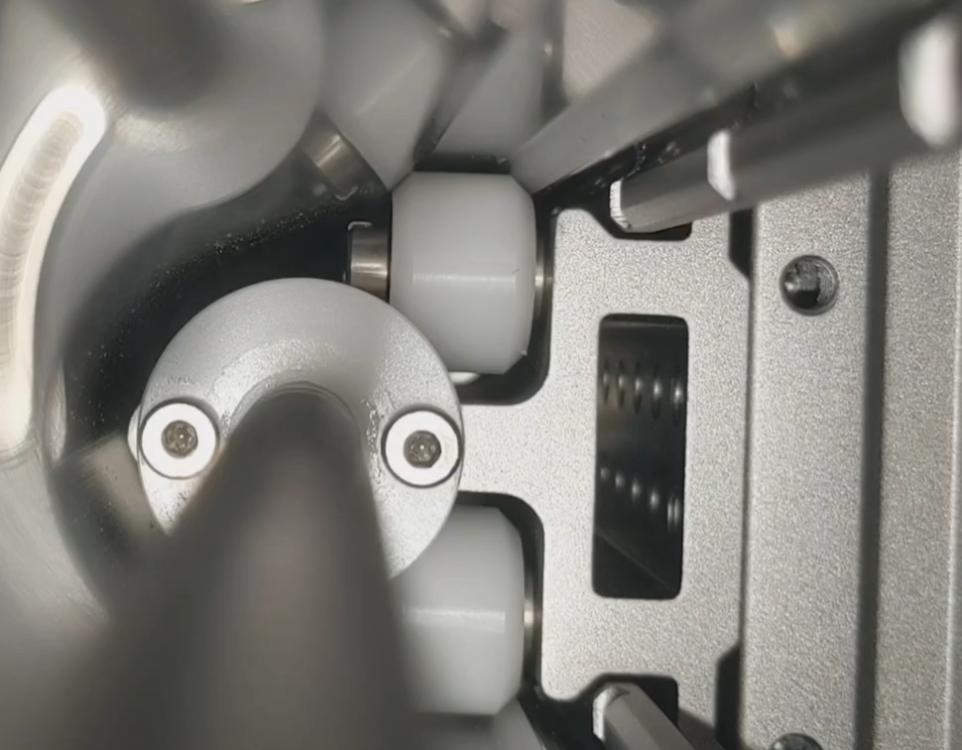
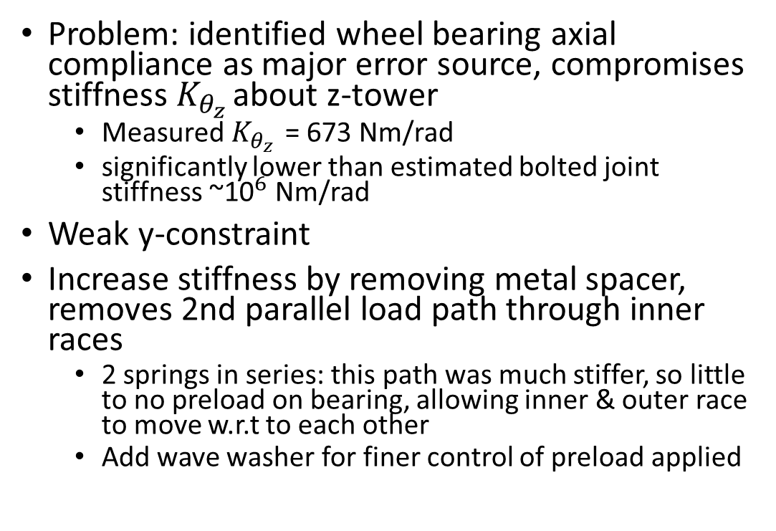
Carriage Stiffness
Problem: identified wheel bearing axial compliance as major error source, compromises stiffness $K_{θ_{z }}$about z-tower
Measured $K_{θ_{z }}$= 673 Nm/rad
significantly lower than estimated bolted joint stiffness ~${\text{10}}^{6}$ Nm/rad
Weak y-constraint
Increase stiffness by removing metal spacer, removes 2nd parallel load path through inner races
2 springs in series: this path was much stiffer, so little to no preload on bearing, allowing inner & outer race to move w.r.t to each other
Add wave washer for finer control of preload applied
y
Video courtesy of Sam Gollob
x
Original design
New design
z
Weak y constraints
Wave washer

Slide 9
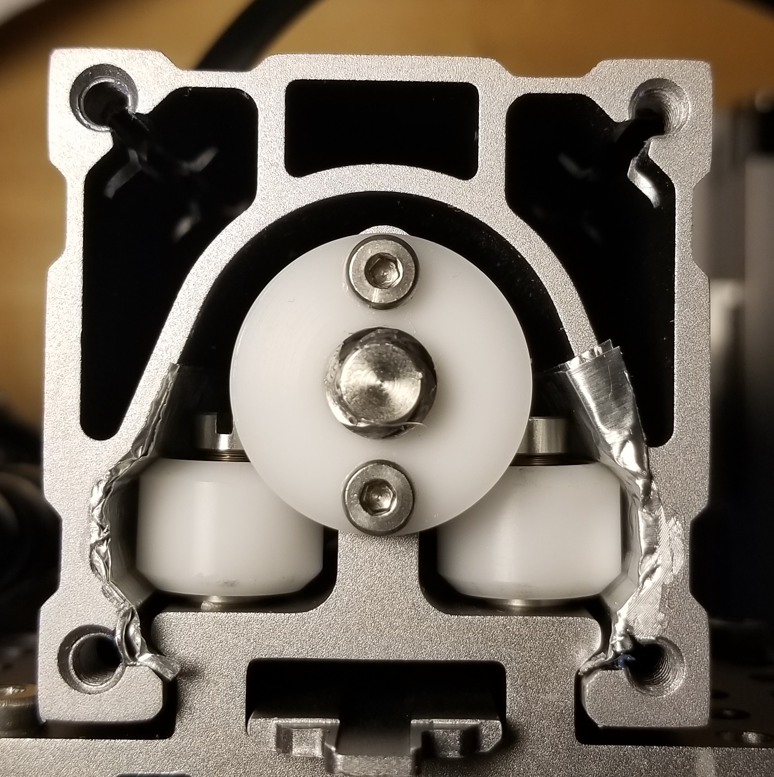
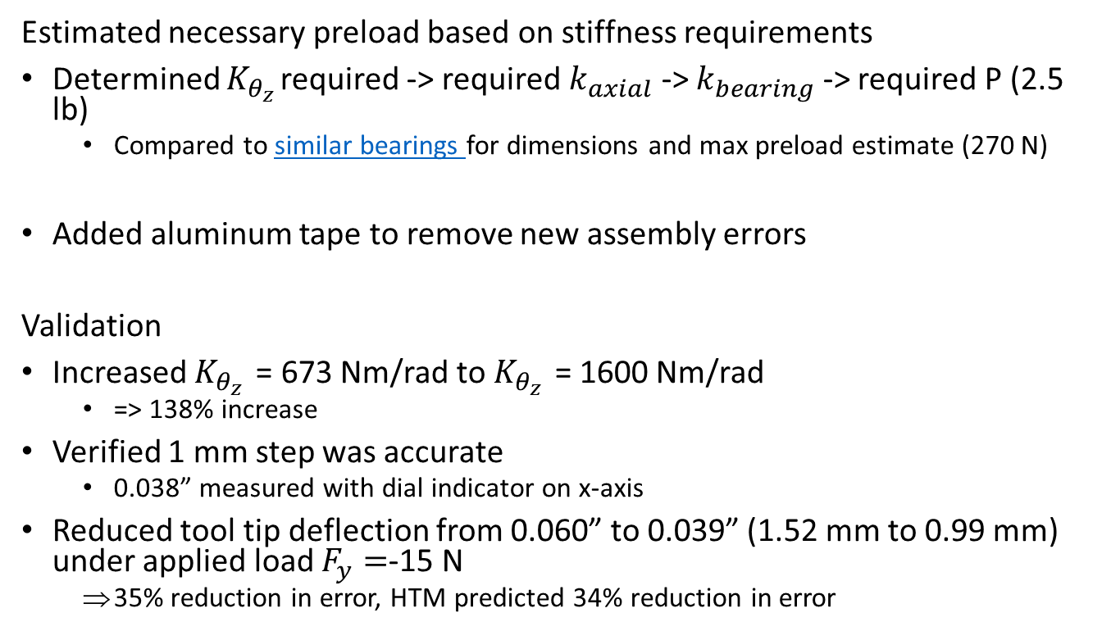
Carriage Preloading
Estimated necessary preload based on stiffness requirements
Determined $K_{θ_{z }}$required -> required $k_{axial}$ -> $k_{bearing}$ -> required P (2.5 lb)
Compared to similar bearings for dimensions and max preload estimate (270 N)
Added aluminum tape to remove new assembly errors
Validation
Increased $K_{θ_{z }}$= 673 Nm/rad to $K_{θ_{z }}$= 1600 Nm/rad
=> 138% increase
Verified 1 mm step was accurate
0.038” measured with dial indicator on x-axis
Reduced tool tip deflection from 0.060” to 0.039” (1.52 mm to 0.99 mm) under applied load $F_{y}=$-15 N
35% reduction in error, HTM predicted 34% reduction in error
y
x
z
P
Notes:
$K_{θ_{z }}$ picked to be similar to bolted joints

Slide 10
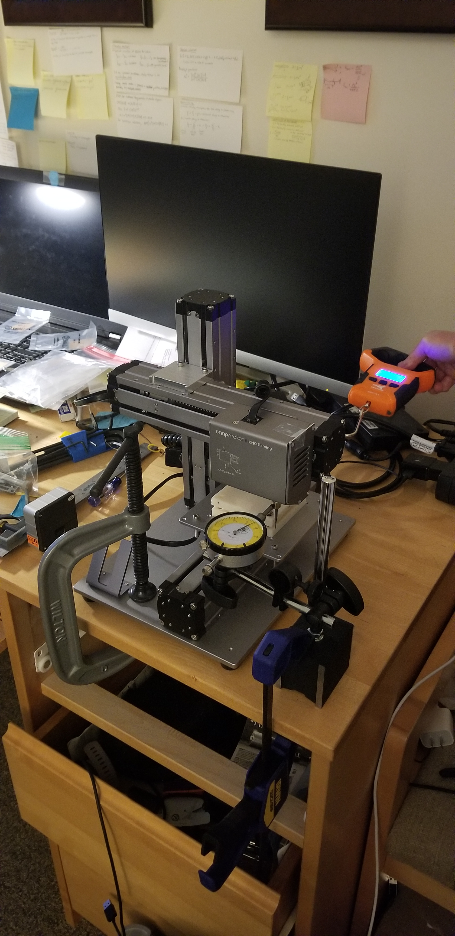
Conclusion
Original error target 100 μm likely requires more extensive design changes
3.125 mm tool alone has 110 micrometer/ 0.004” deflection under 15 N cutting force load in y
Cutting loads were assumed to be too high for this sized tool
Made reasonable performance improvements in time available

Slide 11
Appendix

Slide 12
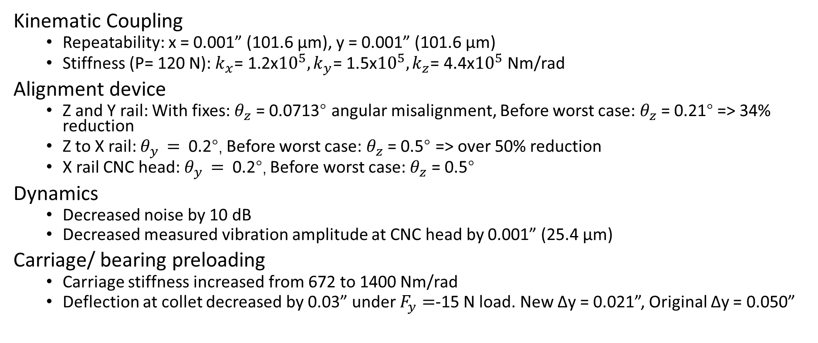
Results
z
y
x
Kinematic Coupling
Repeatability: x = 0.001” (101.6 μm), y = 0.001” (101.6 μm)
Stiffness (P= 120 N): ${k_{x}\text{= }\text{1.2}\text{x}{10}^{5},k_{y}\text{= }\text{1.5}\text{x}{10}^{5}, k}_{z}$= 4.4x${10}^{5}$ Nm/rad
Alignment device
Z and Y rail: With fixes: $θ_{z}$ = 0.0713° angular misalignment, Before worst case: $θ_{z}$ = 0.21° => 34% reduction
Z to X rail: $θ_{y }=$ 0.2°, Before worst case: $θ_{z}$ = 0.5° => over 50% reduction
X rail CNC head: $θ_{y }=$ 0.2°, Before worst case: $θ_{z}$ = 0.5°
Dynamics
Decreased noise by 10 dB
Decreased measured vibration amplitude at CNC head by 0.001” (25.4 μm)
Carriage/ bearing preloading
Carriage stiffness increased from 672 to 1400 Nm/rad
Deflection at collet decreased by 0.03” under $F_{y}=$-15 N load. New Δy = 0.021”, Original Δy = 0.050”
Notes:
Deflection under 15 N load in x and y: Δx = 0.005” (127 μm), Δy = 0.004” (102 μm), 44.5 N load in Δz = 0.004” (102 μm),

Slide 13
Functional Requirements justification
Total Error in y: <100 μm
About 0.004" error in part features is good for a hobbiest machine, below 0.005” better than most desktop CNC
Repeatability in KC positioning in x and y: < 25 μm
https://www.shopbottools.com/products/prs-compare-specs
Shopbot does 50.8 μm
Potential customers want to realign within 25% of minimum feature tolerance needed
Deflection in KC x, y, z: <25 μm
Accuracy in alignment of axes: < 0.5°
To get improvement over current error
Noise level 30 cm away: < 75 dB
Above 80 dB causes hearing damage after 2 hours of exposure - CDC
Vibration deflection: < 25 μm

Slide 14
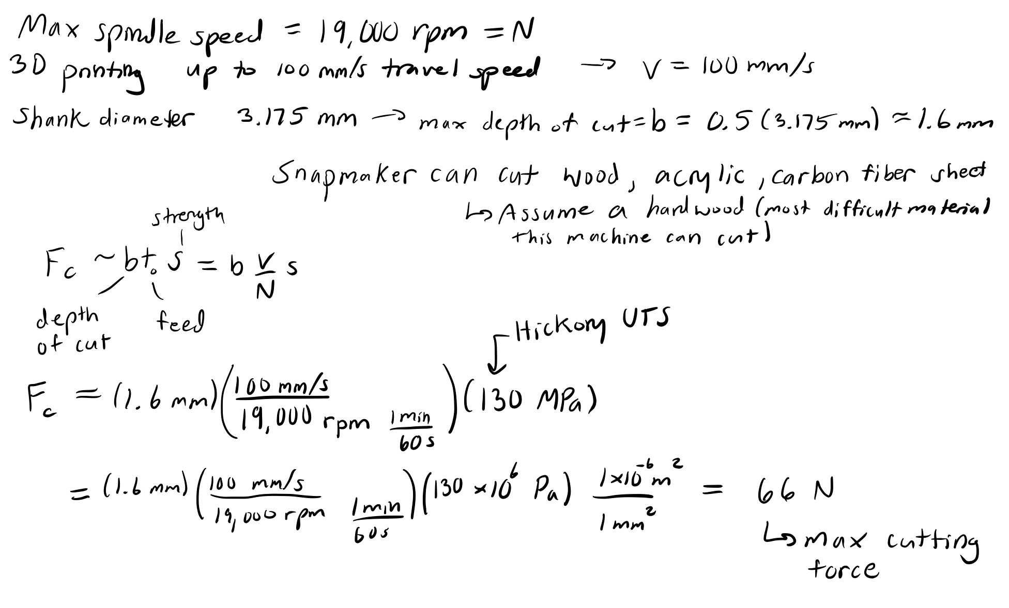
Cutting Force
100 Mpa
2*pi
10 N

Slide 15
Overall extra
3.125 mm tool top has 110 micrometer/ 0.004” deflection along under 15 N cutting force load in y

Slide 16
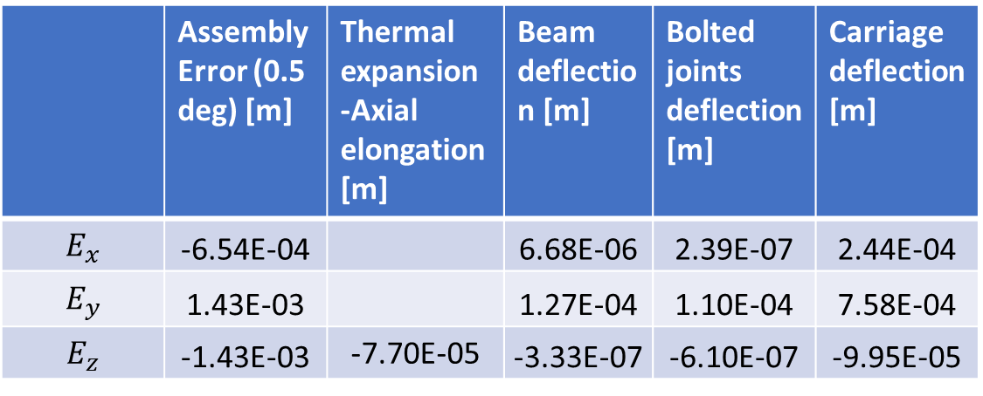

HTM Errors and deflections
https://docs.google.com/spreadsheets/d/1BN8muMtZ_jIjpOrLMos3o2KH6msa1svIYpfPhiIrkeU/edit#gid=0
 | Assembly Error (0.5 deg) [m] | Thermal expansion -Axial elongation [m] | Beam deflection [m] | Bolted joints deflection [m] | Carriage deflection [m]
$$E_{x}$$ | -6.54E-04 |  | 6.68E-06 | 2.39E-07 | 2.44E-04
$$E_{y}$$ | 1.43E-03 |  | 1.27E-04 | 1.10E-04 | 7.58E-04
$$E_{z}$$ | -1.43E-03 | -7.70E-05 | -3.33E-07 | -6.10E-07 | -9.95E-05
 | Bolted joints stiffness [Nm/rad] | Carriage stiffness [Nm/rad]
$$k_{x}$$ | ~10^5 | ~635
$$k_{y}$$ | ~10^5 | ~710
$$k_{z}$$ | ~10^6 | ~672

Slide 17
HTM Total error estimates
HTM total error (deflection beams, bolted joints, and carriage) – no assembly nor thermal error
9.96e-04 with original carriage stiffness
6.57e-04 with improved carriage stiffness
Reduction of 0.0339 micrometers
=> 34% reduction in error

Slide 18
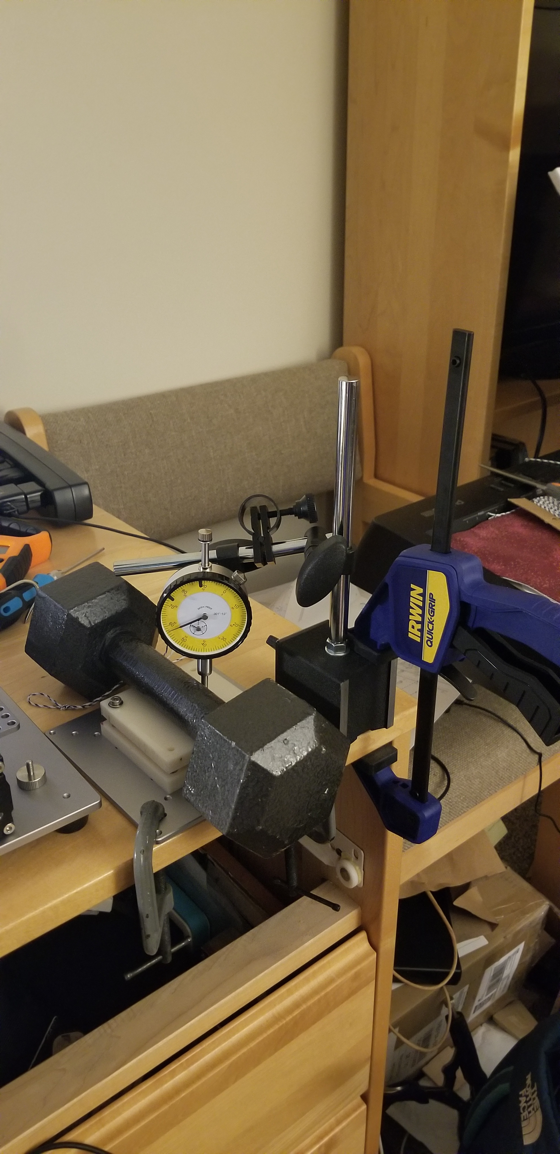
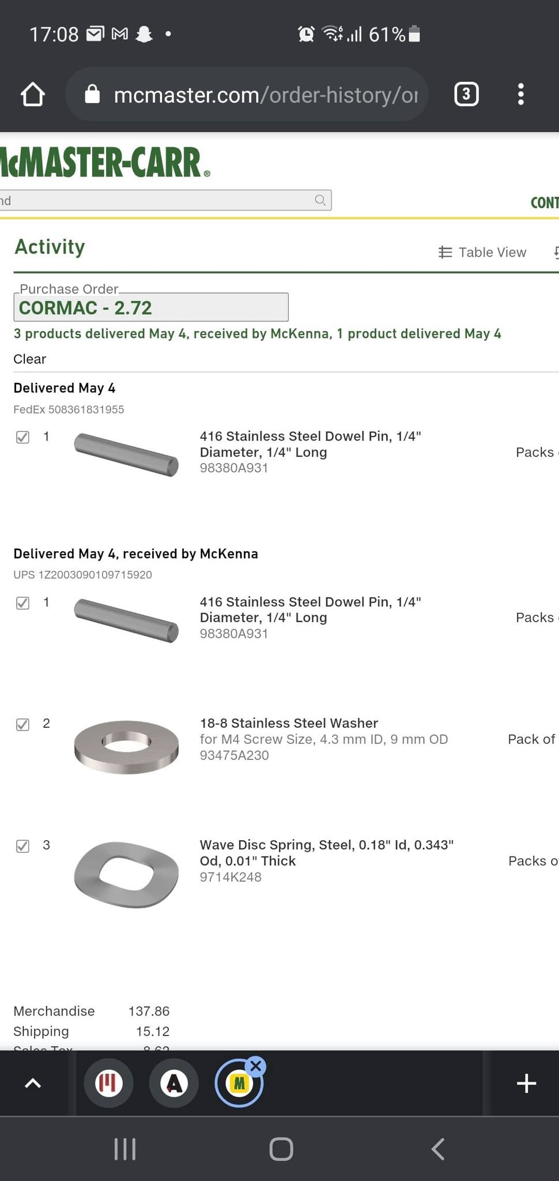
KC extra
Ball diameter fixed based on what given
Adjusted preloads and half angles
Then changed material
Originally 413 steel, contact stresses too high
Using fixture and ball center displacements to calculate predicted displacement

Slide 19
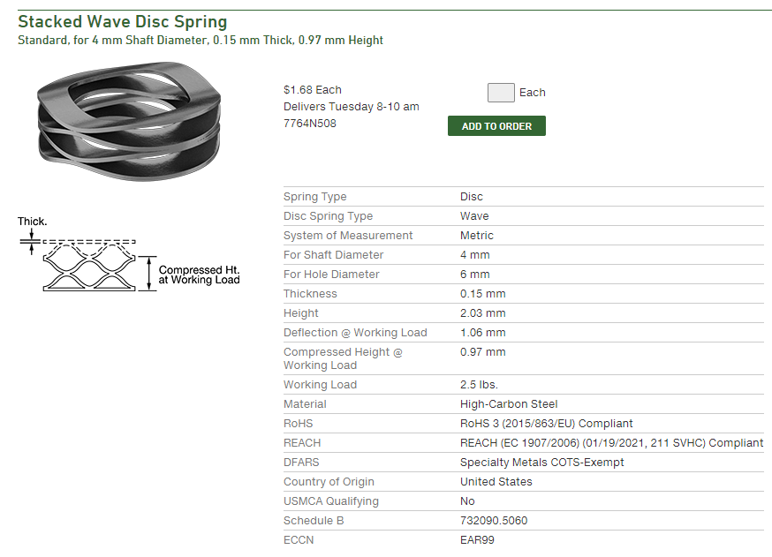
Carriage wave spring
K = 0.01 N/micrometer

Slide 20
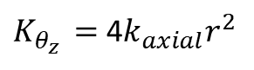
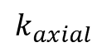
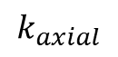
Carriage calcs – relate rotary stiffness about z to bearing wheel axial stiffness
y
x
z
y constraint lines
$$k_{axial}$$
$$k_{axial}$$
r
$K_{θ_{z }}=$ 4$k_{axial}r^{2}$
$$k_{axial}$$

Slide 21
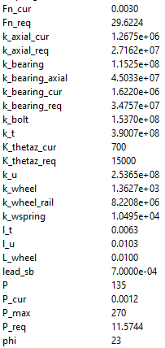
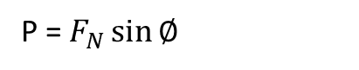
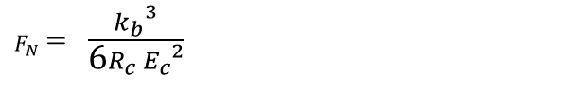
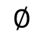
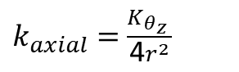
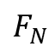
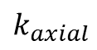
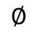
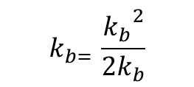
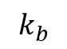
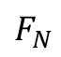
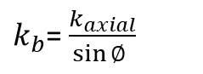
Preload calculation
y
x
$k_{axial}=$ $\frac{K_{θ_{z }}}{\text{4}r^{2}}$
z
P
$k_{b}$= $\frac{k_{axial}}{\sin{∅ }}$
$$F_{N}$$
$$∅$$
$$k_{b= }\frac{{k_{b}}^{2}}{2k_{b}}$$
P
$$F_{N}$$
$$k_{b}$$
$F_{N}$= $\frac{{k_{b}}^{3}}{\text{6}R_{c} {E_{c}}^{2}}$
C.8 (rearranged)*
$$k_{axial}$$
$$∅$$
P = $F_{N}\sin{∅ }$
Misumi bearing ref. – same size as current bearings
*Hale thesis pg 419 C.8 (Hertz Circular contact)
Notes:
delta_theta = (2*pi*P_req)/(k_axial_req*lead_sb)
T = (P_req*lead_sb)/(2*pi)
k_bearing_req = k_bearing_req^2/(2*k_bearing_req);

Slide 22
Appendix B

Slide 23
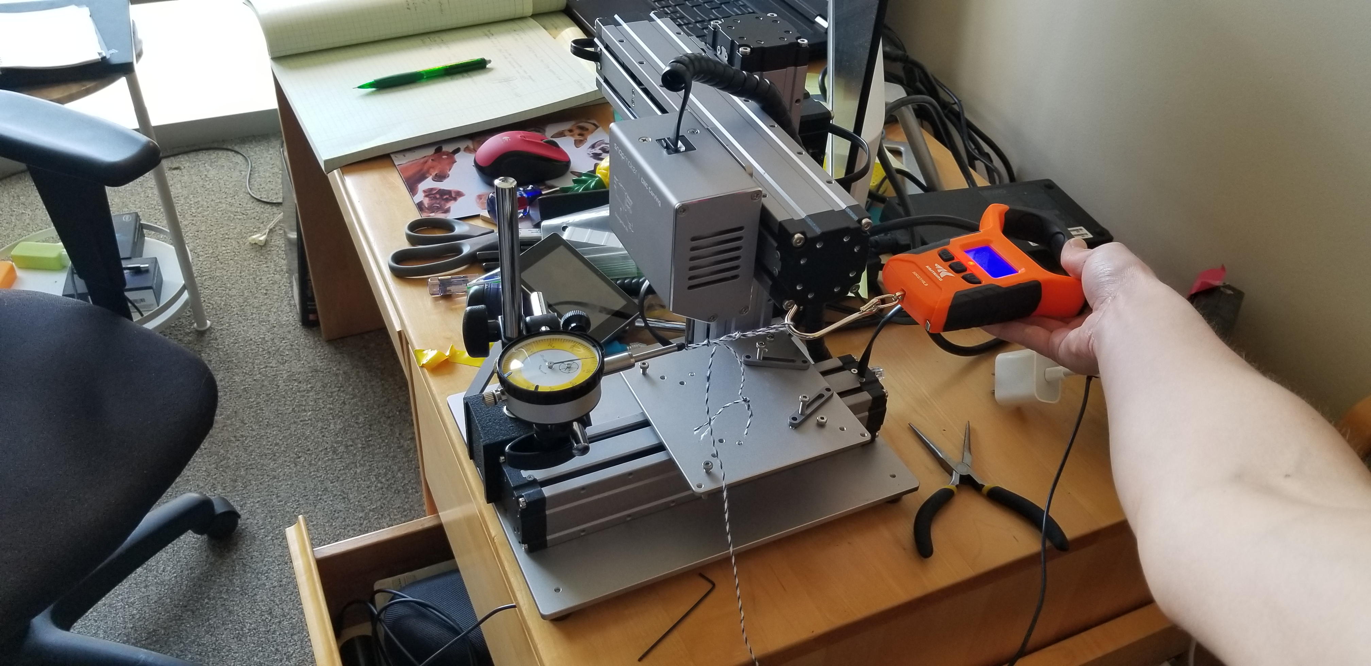
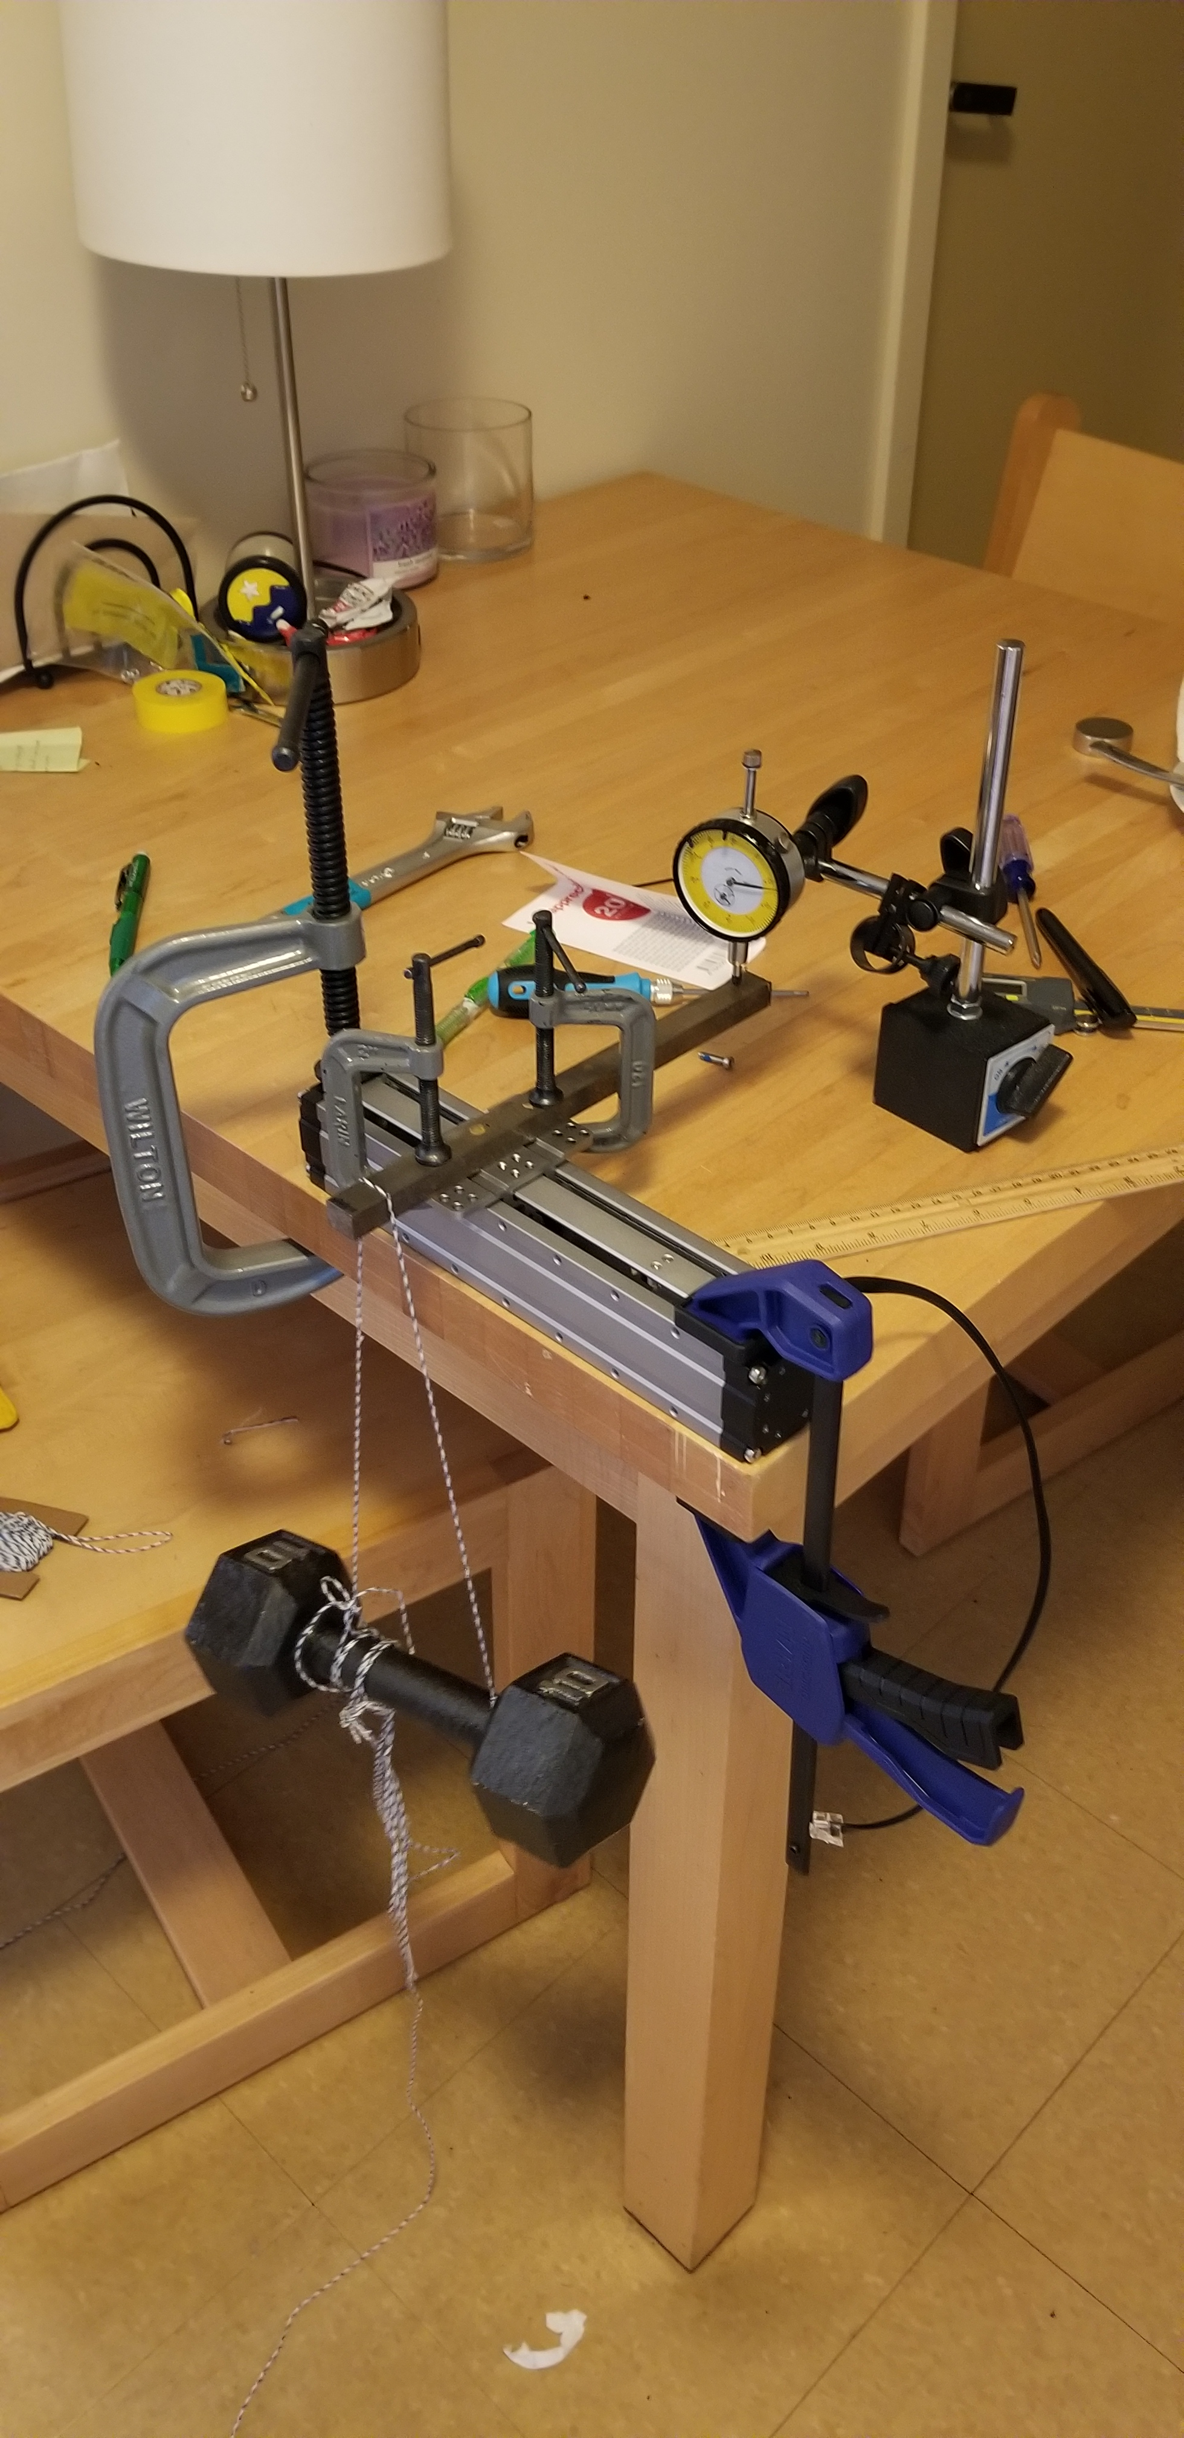
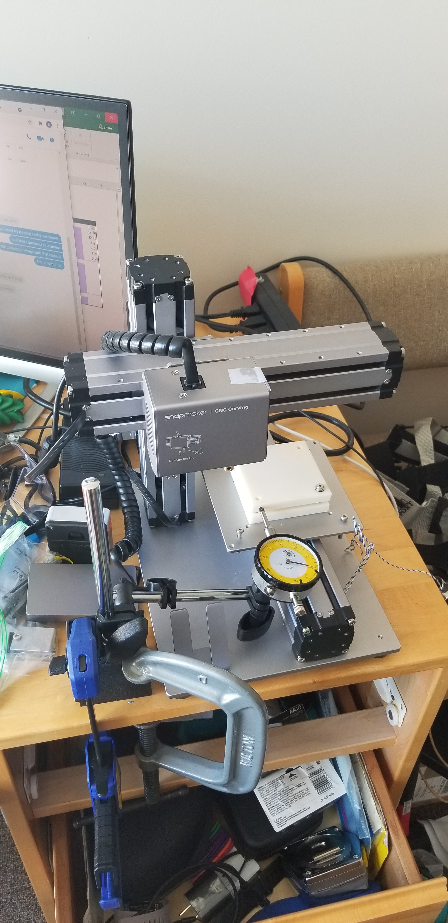
Experiments

Slide 24
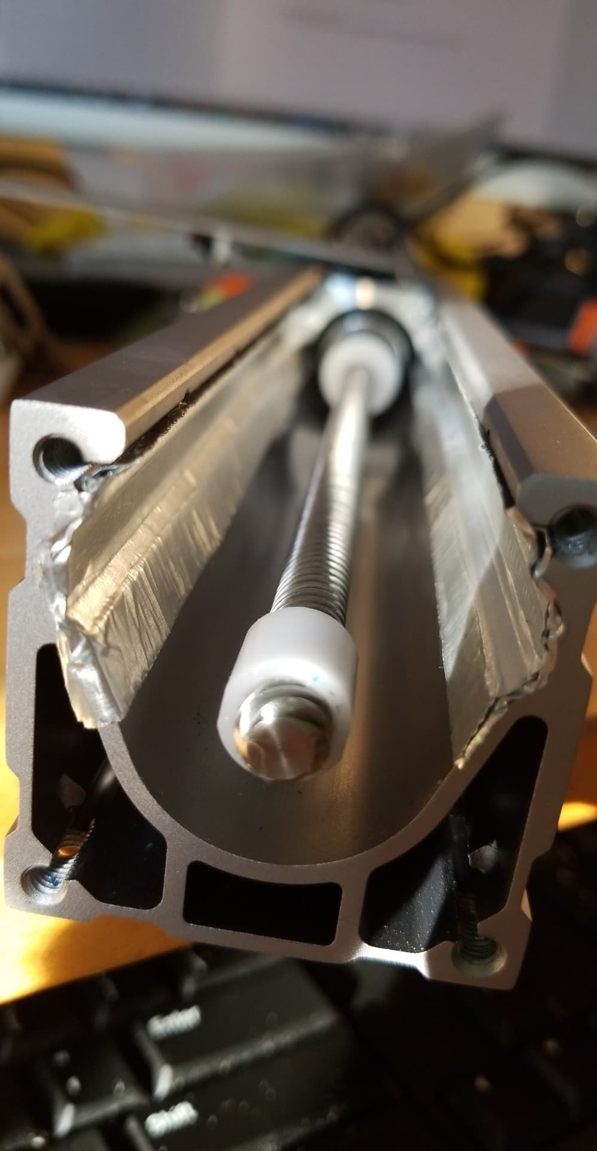



Slide 25


HTM

Slide 26


